Slide 1
Database Engineer Capstone
Giang T. Dang

Slide 2
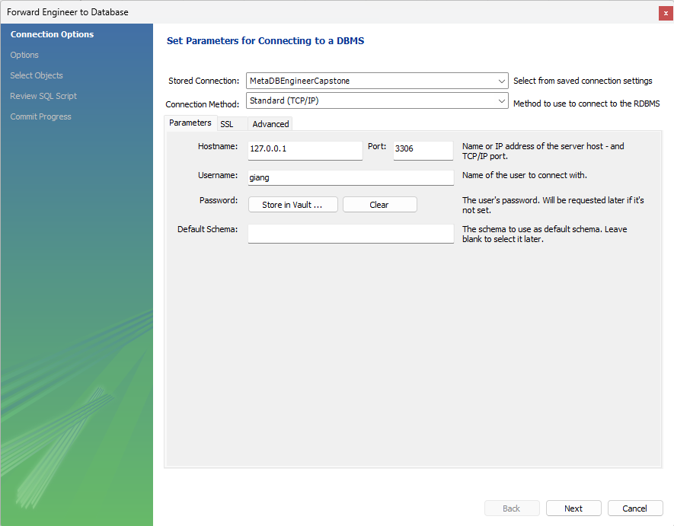

Slide 3
